Slide 1
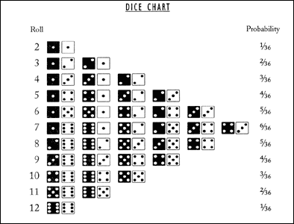
Combinations and State Diagrams
Discrete Structures (CS 173)
Madhusudan Parthasarathy, University of Illinois

Slide 2
Midterm 2 statistics
About 169 people took the exam, and got marks ranging from 34 to 100 (out of 100). Mean: 81.5 Median: 84
Breakdown of scores with approximate letter grades:
90-100 A's 54 (32%) 80's B's 61 (36%) 70's C's 27 (16%) 50-69 D's 21 (12%) < 50 F's 6 (3.5%)

Slide 3
Homework problem

Slide 4
Today’s class
Counting and combinations
State diagrams (mainly applied to counting)

Slide 5
Combinations/counting
How many combinations can I create by drawing from a bag of elements $k$ times?
Does order of draw matter?
Are elements from the bag replaced?
Can an element of the same type be chosen more than once?
Foundation of computing probabilities of discrete events
Questions
How many unique combinations of 3 toppings can I create if there are 8 kinds of toppings?
How many unique bridge/poker hands are possible?
If I flip a coin ten times, what is the chance that heads will come up exactly three times?
If I am trying to roll double ones and get to re-roll, what is the chance I will get it?

Slide 6
Choose $k$ elements from $n$ unique types with full replacement, order matters
$n^{k}$ combinations
Examples
How many different (valid or invalid) 3-colorings are there for a graph with $15$ nodes?
How many unique symbols can I represent with 12 bits of data?

Slide 7
Choose $k$ elements from $n$ unique types with no replacement, order matters
$\frac{n!}{\left(n−k\right)!}$ combinations
Examples
If I have 5 skittles of different flavors, how many different ways can I eat three of them?

Slide 8
Choose $k$ elements from $n$ unique types with no replacement, order doesn’t matter
$\frac{n!}{k!\left(n−k\right)!}≡\left(\begin{matrix}n \\ k\end{matrix}\right)$ combinations
Examples
If I have 5 skittles of different flavors, how many different flavor combinations can I make by eating three at once?
How many 3-topping pizzas can I create if there are 8 types of toppings?
How many possible bridge hands can I have?
How many possible bridge hands can two players have?

Slide 9
Mixed combination problems
Examples
Suppose a slot machine has 6 dials which can each be set to {bell, cherry, 777, blank1, blank2}
How many possible (ordered) combinations are there?
How many ways are there to get exactly three cherries?
How many ways are there to get at least three cherries?

Slide 10
Choose $k$ elements from $n$ unique types with replacement, order doesn’t matter
$\frac{(n+k−1)!}{k!\left(n−1\right)!}≡\left(\begin{matrix}n+k−1 \\ n−1\end{matrix}\right)≡\left(\begin{matrix}n+k−1 \\ k\end{matrix}\right)$combinations
Examples
If you flip a coin 10 times, how many unique head counts can you have?
If you roll ten six-sided die, how many unique combos are possible?
How many combos of 3 pizza toppings, with 8 options, can you make if you can choose the same topping multiple times?

Slide 12
Binomial theorem
Suppose you flip a coin $n$ times. How many ways could you get $k$ heads?
If the coin has an equal chance of being heads or tails, what is the chance of $k$ heads?
What is the chance of there being from $0…n$ heads?
What if there is a 60% chance of heads:
Chance of k heads?
Chance of $0…n$ heads?
In general: ${\left(x+y\right)}^{n}=\sum_{k=0}^{n}{\left(\begin{matrix}n \\ k\end{matrix}\right)x^{n−k}y^{k}}$ (binomial theorem)

Slide 14
Binomial theorem
$${\left(x+y\right)}^{n}=\sum_{k=0}^{n}{\left(\begin{matrix}n \\ k\end{matrix}\right)x^{n−k}y^{k}}$$
Example: ${\left(x+y\right)}^{3}=$

Slide 15
Discrete probability

Slide 16
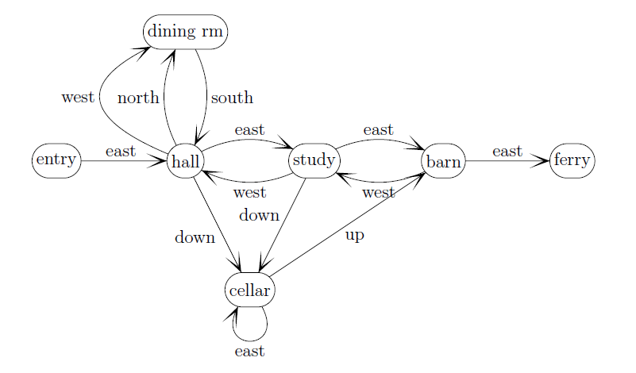
State diagrams
state
transition
action

Slide 19
Things to remember
Combination problems can be broken down into sub-problems of selection and permutation
When elements are drawn uniformly at random, $P(x)$ is number of ways to make $x$ divided by total number of combinations
E.g., $1/6$ chance of rolling “7” total with two dice because there are 6 ways to roll “7” and 36 possible rolls
State diagrams are helpful for calculating odds when multiple turns are involved

Slide 20
Next class
More finite state machines

